Slide 1

Advanced Programming Techniques
Search Engines
Computer Engineering Department
Cairo University

Slide 2
Agenda
Introduction
Types of Search Engines
Crawler-Based Search Engines Components
Web Crawler
Web Crawler Issues
Content Relevance

Slide 3
Introduction
What is Search Engine?
a program that searches for and identifies items in a database that correspond to keywords or characters specified by the user.
a general class of programs that enable users to search for documents on the World Wide Web. like Google, Bing and Yahoo!.

Slide 4
Types of Search Engines
Crawler Based Search Engines
Human Powered Directories

Slide 5
Crawler Based Search Engines
Create their listings automatically using a s/w program to “crawl” or “spider” the web, then index what it finds to build the search engine base.
Web page changes can be dynamically caught by crawler-based search engines and will affect how these web pages get listed in the search results.

Slide 6
Crawler Based Search Engines
Crawler-based search engines are efficient when Searching for a specific search topic BUT in case of Simple search requests may return hundreds of thousands of irrelevant responses.
Examples: Google , AltaVista

Slide 7
Human Powered Directories
Depend on Human editors to build their listings.
Webmasters submit a short description to the directory for their websites, or editors write one for the sites they review, and these manually edited descriptions will form the search base.
Changes made to individual web pages will have no effect on how these pages get listed in the search results.

Slide 8
Human Powered Directories
Human-powered directories are good when searching for a general topic BUT it is not an efficient way to find information when searching for a specific search topic.
Examples: Yahoo Directory, MSN search

Slide 9
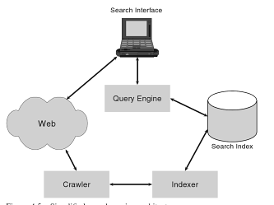
Crawler-Based Search Engines Components

Slide 10
Crawler-Based Search Engines Components
Web Crawler (Spider, s/w robot)
A software program that traverses web pages, downloads them for indexing, and follows the hyperlinks that are referenced on the downloaded pages.
Indexer
A program responsible for creating the search index from the web pages it receives from the crawler.

Slide 11

Crawler-Based Search Engines Components
The Search Index
a data repository containing all the information the search engine needs to match and retrieve web pages.
Used data structure is inverted file
Inverted file (an index at the back of a book): contains all the words appearing in the web pages crawled, listed in alphabetical order, and for each word it has a list of references to the web pages in which the word appear
Notes:
inverted file. It is very much like an index at the back of a book. It contains all the words appearing in the web pages crawled, listed in alphabetical order (this is called the index file), and for each word it has a list of references to the web pages in which the word appear
It is inverted since it is word vs documents and not document vs words

Slide 12
Crawler-Based Search Engines Components
The Search Index
more information is stored for each entry in the index such as the
Number of documents that is the number of web pages that contain the keyword.
Number of occurrences of the keyword in the web page
Position of each occurrence within the page.
This type of information is useful for determining content relevance.
Notes:
DF Document Frequency per word
TF Term Frequency per word in document
Word1 (DF=3) : (doc1, TF=2, heading1, normal) (doc3) ( doc5)

Slide 13
Crawler-Based Search Engines Components
The Search Index
Store information pertaining to hyperlinks in a separate link database, which allows the search engine to perform hyperlink analysis, which is used as part of the ranking process of web pages.
Notes:
The link database can also be organized as an inverted file in such a way that its index file is populated by URLs and the posting list for each URL entry, called the source URL, contains all the destination URLs forming links between these source and destination URLs.
The link database for the Web can be used to reconstruct the structure of the web and to have good coverage, its index file will have to contain billions of entries

Slide 14
Crawler-Based Search Engines Components
The Query Engine
provides the interface between the search index, the user, and the Web.
Processes a user query in two steps:
Retrieves from the search index information about potentially relevant web pages that match the keywords in the user query
Ranks the results.

Slide 15
Crawler-Based Search Engines Components
The Search Interface
Displays the results from the query engine on the user’s screen.

Slide 16
Web Crawler
If the Web was static and none of its content ever changed, a search engine would only have to crawl the Web once.
But the Web is continuously evolving with new pages appearing and old ones either changing or disappearing altogether.

Slide 17
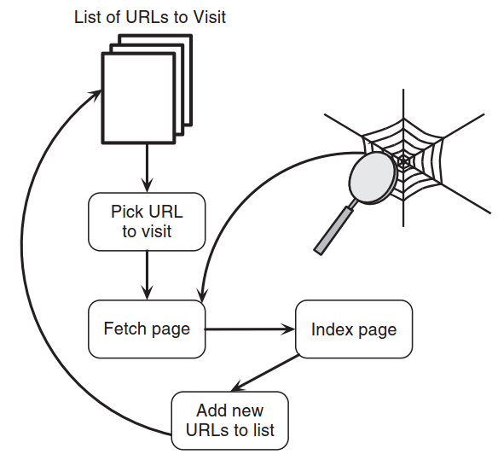
Basic Crawler Algorithm
Seed
Set
The process normally terminates after
a certain number of web pages have
been indexed or a certain time has elapsed.
Notes:
seed set must not only contain at least one URL from the largest strongly connected component of the web graph, so as to be able to reach as many web pages as possible, but it must also contain URLs from other parts of the Web to cover pages not reachable from the core.
The list of URLs used by the crawler is dynamic; once a page is visited, it is removed from the list and after the links on a page being processed are identified, they are added to the list of remaining URLs to visit

Slide 18
Crawler Issues
Detecting duplicate web pages having different URLs (web page addresses)
Solution: mapping each URL to a compact string representing the content on the page, and comparing the content string of each new URL to existing ones

Slide 19
Crawler Issues
The problem of which web pages to visit first ?!!
FIFO
Using the link structure of pages, for example URLs having more hyperlinks pointing to them may be prioritized, which gives more importance to popular pages.
Using the domain : a URL ending in “.com” may deemed to be more important than other URLs
Notes:
when using link metrics to evaluate the quality of a page, the breadth-first strategy is very competitive, efficient, and discovers high-quality pages early in the crawl.

Slide 20
Crawler Issues
Scheduling Problem : when to start new crawl ???!!!
Native strategy : schedule a new crawl of the Web immediately after the current crawl is finished, and to update the search index after each crawl.
Notes:
Dynamic HTML Pages having embedded scripts that can modify not only the look of a web page but
also its contents, depending on the events occurring in the browser when the page
is being viewed.

Slide 21
Crawler Issues
How often the crawler should refresh its pages ??!!!
The simplest approach : revisit all pages at the same frequency.
More sophisticated approach: revisit pages that change more often, more frequently (like news sites, ecommerce sites)
Notes:
although most web pages do not undergo much change, larger web pages tend to change more often and to a larger extent than smaller ones. It was also shown that change is more frequent and extensive for pages whose top-level domain is .com or .net, than for pages from other domains such as .edu and .gov. It also turns out that past change to a web page is a good indicator of future change, which is encouraging for prediction purposes.

Slide 22

The Robot Exclusion Protocol
Web sites that wish to exclude crawlers from indexing some of their web pages can indicate this preference through the robots exclusion protocol. This is done by keeping a text file called robots.txt in the root directory of the website
all crawlers should
not visit any URLs
starting with
“/docs” or “/logs”.
Notes:
Crawlers need to be polite. By this, we mean that they should spread their visits to a particular web site over a period of time, since bombarding a web site with HTTP requests (the protocol for requesting a web page from a site) within short intervals will slow down the web site for human users
- The “*” indicates that the exclusion pertains to all crawlers. If for some reason a web site only wishes to exclude Googlebot (the name of Google’s crawler) or Slurp (the name of Yahoo’s crawler) from these URLs, then the “*” is replaced by Googlebot or Slurp.

Slide 23

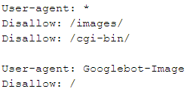

Samples of Robot.txt
Notes:
This means that the Google image search robot, "Googlebot-Image", should not try to access any file in the root directory "/" and all its subdirectories. This effectively means that it is banned from getting any file from your entire website.
Example 2:
Multiple lines
Example3:
Remember to add the trailing slash ("/") if you are indicating a directory
he robots will be disallowed from accessing privatedata.html as well as privatedataandstuff.html as well as the directory tree beginning from /privatedata/(and so on). In other words, there is an implied wildcard character following whatever you list in the Disallow line.

Slide 24
Robot.txt Examples
User-agent: *
Disallow: /cyberworld/map/
Disallow: /tmp/
Disallow: /foo.html
User-agent: *
Disallow:/
User-agent: *
Disallow: /cyberworld/map/
User-agent: cybermapper Disallow:
Notes:
The first file specifies that no robots should visit any URL starting with "/cyberworld/map/" or "/tmp/", or /foo.html:
The next file specifies that no robots should visit any URL starting with "/cyberworld/map/", except the robot called "cybermapper
The thirs file indicates that no robots should visit this site further:

Slide 25
Indexer
The indexer must preprocess web pages before the information is put in the inverted file. This involves, amongst other things, splitting the page into words, detecting meta-information such as HTML tags, detecting stop words(A,An,….) that are often omitted from queries, and stemming of words.
Stemming is a technique for removing the suffixes of a word to expose its root form known as its stem (Computer -> Comput and its varients Computations, Computers, Computing,…)

Slide 26
Indexer
Stemming reduces variations of common words to a single stem thus reducing the size of the vocabulary included in the index.
The effect of stemming is an increase in the number of documents retrieved for a given keyword and the recall (the ratio of the number of relevant records retrieved to the total number of relevant records in the database. It is usually expressed as a percentage. ) of the system is also increased.
Is the PRECISION increased too ??
Precision is the ratio of the number of relevant records retrieved to the total number of irrelevant and relevant records retrieved.
Notes:
but it does not necessarily imply that the results list will contain a higher proportion of relevant pages, that is, the precision of the system may in fact decrease.
Precision is the fraction of the documents retrieved that are relevant to the user's information need.
Precision is the number of relevant results returned divided by the total number of results returned.

Slide 27
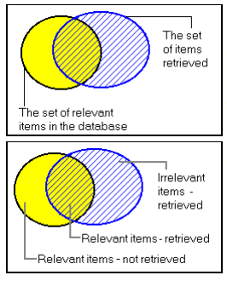
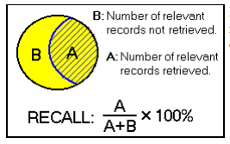
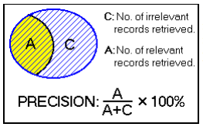
Recall Vs. Precision

Slide 28
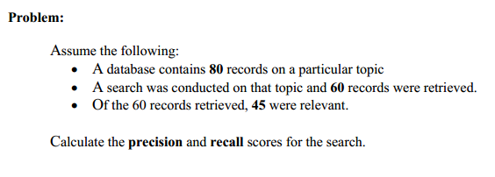
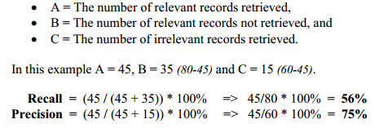
Example

Slide 29
Indexer
Famous search engines like Google, AltaVista didn’t support stemming at all BUT they use Partial Stemming(focus on plurals and the most common suffixes such as ED and ING.)
Notes:
Stemming may not improve the relevance of the first page of results returned by the query engine.
One further issue worth mentioning is that before inserting the word into the index, the indexer may wish to convert all words to lower case to reduce the size of the word index. On the other hand, in some circumstances we may wish to retain the original so as to be able to discriminate, for example, between “Explorer” (a shorthand for Microsoft Internet Explorer) and “explorer.” Google and Yahoo do not distinguish between upper and lower case letters; however, AltaVista did, when the keywords were surrounded by double quotes.

Slide 30

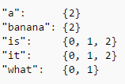
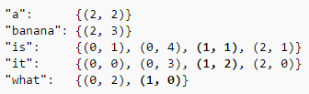
Indexing Example
Given the texts
Inverted Files

Slide 31
Content Relevance
How do we measure relevance of a webpage to a query???
Term Frequency (TF): counting the number of occurrences of the word in the document
The computation of TF should take into account the length of a document, since otherwise longer documents will be favored as they are more likely to have more occurrences of any keyword.
Simplest way to normalize TF is to divide it by the length of the document.
Notes:
TF is based on the observation that the frequency of occurrence of a term in a document is a useful indication of whether this term is meaningful in the context of the document. So, web pages about backgammon should have a high TF for the keyword “backgammon,” and, moreover, if the page is about computer backgammon, the combined TF values for “computer” and “backgammon” should be high.

Slide 32
Content Relevance
A very high TF value for a non-stop word is suspicious in any case and can indicate one of two problems.
It could be due to a very short document.
It could be spam.
For example, if the same word is repeated too often, say over 50% of the time, the document will generally not make sense. These sort of anomalies can be detected by search engines and dealt with, by biasing against pages containing words with an abnormally high TF.
Notes:
for example, if the same word is repeated too often, say over 50% of the time, the document will generally not make sense. These sort of anomalies can be detected by search engines and dealt with, by biasing against pages containing words with an abnormally high TF.

Slide 33
Content Relevance
How do we measure relevance of a webpage to a query???
Inverse Document Frequency (IDF): dividing the total number of documents by the number of documents in which the term appears.
Low-frequency terms having higher IDF are better at narrowing down the set of relevant documents that the user is interested in given the query.
IDF = log(total number of documents/number of documents containing the term).
Notes:
TF is based on the observation that the frequency of occurrence of a term in a document is a useful indication of whether this term is meaningful in the context of the document. So, web pages about backgammon should have a high TF for the keyword “backgammon,” and, moreover, if the page is about computer backgammon, the combined TF values for “computer” and “backgammon” should be high.

Slide 34
Content Relevance
IDF is not as easy to spam as TF, WHY?!!!!
Its computation is based upon global knowledge relating to the Web; that is, in how many documents, in the Web as a whole, does a word appear.
Spammers that add to their web pages words that have high IDF, that is, words which are rare on the web, will obviously gain a high ranking for these words. But since, these rare words do not convey much meaning and web searchers are unlikely to use them as query terms unless they actually wish to view the spammed pages, the spammers would not have gained much for their effort.
Notes:
IDF is not as easy to spam as TF, since, unlike TF, its computation is based upon global knowledge relating to the Web; that is, in how many documents, in the Web as a whole, does a word appear. So, spammers that add to their web pages words that have high IDF, that is, words which are rare on the web, will obviously gain a high ranking for these words. But since, as we have discussed above, these rare words do not convey much meaning and web searchers are unlikely to use them as query terms unless they actually wish to view the spammed pages, the spammers would not have gained much for their effort.

Slide 35
Content Relevance
TF–IDF is the baseline method for computing content relevance.
The TF-IDF values are computed for each keyword in the query and each web page that contains at least one occurrence of that keyword.
Once we have the TF and IDF values for each keyword and every webpage in which it appears, we compute the TF–IDF value for a keyword in a web page by multiplying the TF value for the keyword in the page by its IDF value.
Sum up the TF–IDF values of all the keywords in the query for each web page in which all the keywords appear at least once to obtain the final TF–IDF values which the query engine then uses to rank the web pages.
Notes:
Note that we rank only web pages that include all the keywords, since this is the default interpretation of search engines; this could be relaxed to include web pages that have at least one occurrence of any keyword with the query
Let us examine Archie’s query “computer backgammon” in more detail. To compute the TF–IDF for a given keyword, say “backgammon,” we compute the TF for each web page that has at least one occurrence of “backgammon,” and multiply this by its IDF value. The TF value is obtained from the posting list of the inverted file entry for “backgammon,” while the IDF value is obtained from the inverted file index entry for “backgammon.”

Slide 36
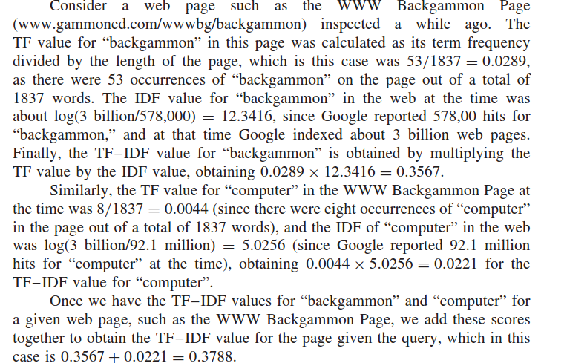

Slide 37
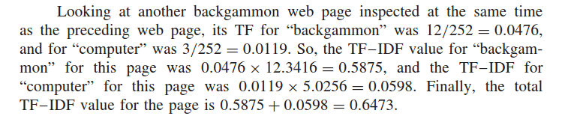
Page 1 TF-IDF = 0.3788
Page 2 TF-IDF = 0.6473
Page 2 Rank > Page 1 Rank
Notes:
To come over large computation problem we can use Cashed queries :
search engines can reduce their computations is by caching queries. Caching a query simply means storing precomputed results of the query on the search engine’s servers, so that these results can be accessed directly without further computation when the query is issued.
here is also a case to be made for user side caching of queries; that is, caching frequent queries made by an individual searcher on their local machine

Slide 38
Content Relevance
Search engines augment TF–IDF with further analyses to improve relevance scoring:
Phrase Matching
Synonyms
Link Text
Notes:
Phrase Matching :
attach a higher weight to web pages having the exact phrase “computer backgammon”. In general, the query engine will prefer matches where the distance between the keywords is small, so the match “computer backgammon”, where the distance between the query terms is one, is considered better than the match “computer plays backgammon”, where the distance between the query terms is two. The query engine can deduce the distance between the keywords from the position of each matched term within the web page, which is stored in the entry for the page in the posting list. The exact weights that a search engine attaches to these factors is a well kept secret.
Synonyms:
For a keyword such as “facts” a search engine could recognize that it is synonymous with “information” and match web pages that contain either keyword. This could be achieved by using a thesaurus to expanding the query, so that the query “facts” would be rewritten as “facts OR information.”
The main problem with expanding queries as the default behavior is, foremost, the additional number of results generated for the query, increasing recall but not necessarily precision.
Link Text :
One technique pioneered by Google is to include the linktext (also known as anchor text) with the web page that is referenced by the link.
For example, on my home page I have a link to the home page of the department, whose link text is “Department of Computer Science and Information Systems”. This link text is then associated with the home page of the Department.
The link text may be weighted by some measure of the strength of the link,

Slide 39
Review
Introduction
Types of Search Engines
Crawler-Based Search Engines Components
Web Crawler
Web Crawler Issues
Content Relevance

